Slide 1
Certification Program in
Business Analytics & Optimisation
From IITD
Data Driven Case Study 1
From:
Shivesh Kumar Sareen
shivesh72@gmail.com

Slide 2
Trend in UPI payment Transactions during COVID
Unified Payments Interface (UPI) is a system that powers multiple bank accounts into a single mobile application (of any participating bank), merging several banking features, seamless fund routing & merchant payments into one.
Instant transfer of fund through Immediate Payment Service (IMPS), which is faster than NEFT.
Since it is digital, one can use UPI 24 hours and on all public holidays.
Single mobile application for accessing various bank accounts.
UPI is the next big boost to the digitization of banking and financial sector. It will transform the habit of citizens and help in moving towards the world of cashless economy.

Slide 3
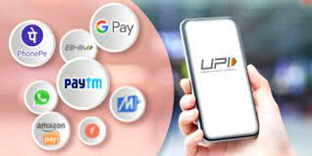
Objectives of the Case Study
To Identify the Volume of UPI during the Covid 19 Lock down.
Examples of Usage of UPI
Seamless in - app payment within the same mobile of the user.
DTH payment from home.

Slide 4
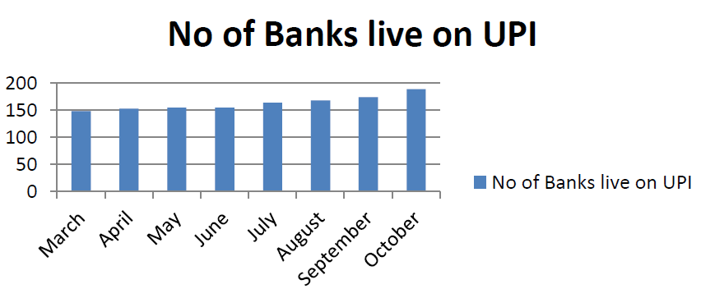
Month | No. of Banks live on UPI
Mar 20 | 148
April 20 | 153
May 20 | 155
June 20 | 155
July 20 | 164
Aug 20 | 168
Sept 20 | 174
Oct 20 | 189

Slide 5
Conclusion
During Covid, major issue was contact tracing, people wanted to avoid doing payments in cash. This in turn boosted the digital payment ecosystem. Covid in a way, fast tracked the growth of digitization in the payment sector.
There was rapid increase in UPI payments during Covid 19 lockdown, people prepared to use UPI instead of cash and UPI payments helped to ensure social distancing.
In October 2020, 189 banks joined UPI and total transactions amount stood at around 3.86 lakh crore. There is an around 73% increase in amount transacted in lock down as compared with amount transacted before lock down.
UPI system have made life of people very easy, people can transfer/receive money whenever they want, allowed cell phone to be used as an vital installment gadget for making and tolerating installments.
UPI have helped India to improve its financial system. UPI, allows even the smallest merchant to begin accepting advanced payments without the requirement for any POS machine. UPI have helped people in lockdown, people were able to pay for the goods they needed.

Slide 6
THANK YOU

